Slide 1
OOP FINAL PROJECT
Restaurant()
Restaurant
Management System
Order()
MenuItem()
Object-oriented design in Python: classes, inheritance, polymorphism, encapsulation and composition
Discount()
OOP Project | By: Yomn Osama
Notes:
Introduce the project in one sentence. Stress that the focus is the object-oriented design, not the interface.

Slide 2
THE REAL-WORLD PROBLEM
Small restaurants run on paper and memory
1
2
3
Paper and memory
No single view
Slow at peak time
Orders, tables and customers are tracked by hand, so mistakes and lost details are common.
Staff cannot quickly see which tables are taken, what is on the menu or what is owed.
Recalculating bills and searching records wastes minutes when the restaurant is busiest.
Solution
Model the restaurant as objects (tables, menu, customers, orders, payments) so the business rules live in the classes and the totals are always calculated automatically.
Notes:
Explain the real problem first: orders, tables and bills tracked by hand cause mistakes. The plan: requirements, class design, OOP, business logic, file storage, GUI, testing.

Slide 3
ARCHITECTURE
Layers with one job each
gui/ RestaurantApp
(Tkinter, thin client)
models/ Restaurant
(business rules)
services/ RestaurantService
(object <-> dict)
The interface can change without touching the rules. JSON can be swapped for a database by replacing one class.
exceptions.py
RestaurantError tree
file_manager/ FileManager
(JSON read / write)
Every layer raises and catches the same custom exceptions.
Notes:
The GUI calls the model; the service converts the model to and from dictionaries; the FileManager is the only class that touches the disk.

Slide 4
CLASS DIAGRAM
The classes and how they relate
Restaurant
menu, tables, customers, orders: dict | payments: list
create_order() checkout_order() dashboard_stats()
Table
Order
OrderItem
MenuItem
has many
refers to
table_id, capacity, status
occupy() free()
order_id, table_id, status
items, discount
add_item() checkout()
menu_item, quantity
subtotal
name, category, __price
price (property)
Customer
customer_id, name, phone
matches()
has one
Discount (ABC)
NoDiscount
Percentage
Discount
FixedAmount
Discount
Payment
apply() describe()
payment_id, order_id, amount
method, timestamp
subclasses
Table, Customer and Payment are linked to orders by id.
Notes:
Walk through: Restaurant owns everything. Order has OrderItems, each pointing to a MenuItem, and Order has one Discount. Table, Customer and Payment are linked by id.

Slide 5
CONSTRUCTORS AND TYPE HINTS
__init__ builds valid objects only
class Table:
def __init__(self, table_id: int,
capacity: int,
status: str = AVAILABLE) -> None:
if capacity <= 0:
raise ValidationError(
"Table capacity must be > 0.")
self.table_id: int = table_id
self.capacity: int = capacity
self.status: str = status
Validation inside
Table, Payment, OrderItem and the Discount classes reject bad input in __init__
Default values
status defaults to Available; Order sets created_at to now and discount to NoDiscount
Type hints everywhere
Every parameter, return value and attribute is annotated, for example -> None and Dict[str, Any]
Notes:
Constructors validate their input so an invalid object can never exist. Type hints are used on every parameter and return value across the project.

Slide 6
ENCAPSULATION
MenuItem protects its own price
class MenuItem:
def __init__(self, item_id, name,
category, price, available=True):
self.__price = 0.0
self.price = price # uses the setter
@property
def price(self): return self.__price
@price.setter
def price(self, value):
if value <= 0:
raise ValidationError("Price > 0")
self.__price = round(float(value), 2)
Private attribute
__price is name-mangled and hidden from outside code
Property getter / setter
item.price reads like a field but runs validation
Validation at the source
The constructor and updates both go through the setter
Notes:
The price is stored in a private attribute. The property setter is the only way in, so an invalid price can never be stored.

Slide 7
ABSTRACTION AND INHERITANCE
Discount: an abstract base class
Discount (ABC)
class Discount(ABC):
@abstractmethod
def apply(self, total: float) -> float:
"""Total after the discount."""
@abstractmethod
def describe(self) -> str:
"""Short readable description."""
NoDiscount
PercentageDiscount
FixedAmountDiscount
Each subclass supplies its own apply() and describe(). Constructors validate their own input
(percent 0-100, amount > 0).
Notes:
Discount cannot be instantiated. It defines the contract (apply and describe) that every discount type must implement.

Slide 8
POLYMORPHISM
One call, three behaviours
NoDiscount()
-> 100.00
def calculate_total(self) -> float:
return round(
self.discount.apply(
self.calculate_subtotal()), 2)
# default: no if/else needed
self.discount = discount or NoDiscount()
PercentageDiscount(10)
-> 90.00
FixedAmountDiscount(15)
-> 85.00
Subtotal = 100.00 in all three rows
Adding a new discount type (for example buy-one-get-one) means writing one new subclass. Order, Restaurant and the tests stay unchanged.
Notes:
Order never checks which discount it holds. It just calls apply(), and the object decides the result.

Slide 9
INHERITANCE
A custom exception hierarchy
RestaurantError (Exception)
ValidationError
TableNotFoundError
Why it matters
TableOccupiedError
MenuItemNotFoundError
Each rule has a named error, such as TableOccupiedError or EmptyOrderError.
One except RestaurantError block catches all of them.
The GUI shows str(error) to the user.
MenuItemUnavailableError
InvalidQuantityError
EmptyOrderError
OrderNotFoundError
CustomerNotFoundError
InvalidPaymentError
Notes:
Every error inherits from RestaurantError, so callers can catch one specific error or the whole family.

Slide 10
COMPOSITION AND ASSOCIATION
How the objects fit together
Restaurant
has many
Order
has many
OrderItem
refers to
MenuItem
Discount
Composition
Aggregation
Association by id
Restaurant holds dicts of MenuItem, Table, Customer and Order objects. Order holds a list of OrderItem.
OrderItem keeps a reference to a shared MenuItem. Order holds a Discount.
Order stores table_id and customer_id, and Restaurant looks them up.
Notes:
Restaurant owns collections of objects. Order owns its OrderItems. Orders refer to tables and customers by id to stay loosely coupled.

Slide 11
RESPONSIBILITY AND DELEGATION
Restaurant coordinates, objects do the work
Order.checkout()
def checkout_order(self, order_id,
method="Cash"):
order = self.get_order(order_id)
total = order.checkout()
payment = Payment(self._next_payment_id,
order_id, total, method)
self.payments.append(payment)
self._next_payment_id += 1
self.get_table(order.table_id).free()
return payment
validates not empty, sets status to Paid
Payment(...)
validates amount > 0, stamps the time
Table.free()
status goes back to Available
Notes:
checkout_order asks Order to check out, creates a Payment and tells Table to free itself.

Slide 12
BUSINESS RULES
Three rules the objects enforce
Occupied table
Quantity above zero
No empty checkout
Table.occupy()
OrderItem.__init__()
Order.checkout()
if self.status == OCCUPIED:
raise TableOccupiedError(
"Table is already occupied.")
if quantity <= 0:
raise InvalidQuantityError(
"Quantity must be > 0.")
if self.is_empty:
raise EmptyOrderError(
"Order has no items.")
TableOccupiedError
InvalidQuantityError
EmptyOrderError
The order total is never typed in: calculate_total() always computes it from the items and the discount.
Notes:
Demo these three live: occupied table, zero quantity, empty checkout. Each one raises a specific exception that the GUI turns into a message.

Slide 13
PERSISTENCE
Objects to JSON and back
Restaurant
@classmethod
def from_dict(cls, data):
return cls(
customer_id=data["customer_id"],
name=data["name"],
phone=data.get("phone", ""))
# Order.to_dict stores the discount type:
{"type": self.discount.__class__.__name__}
RestaurantService
FileManager
restaurant_data.json
Only FileManager touches the disk, and _discount_from_dict rebuilds the correct Discount subclass when loading.
Notes:
Each model knows how to describe itself as a dictionary. RestaurantService rebuilds the full object graph on load.

Slide 14
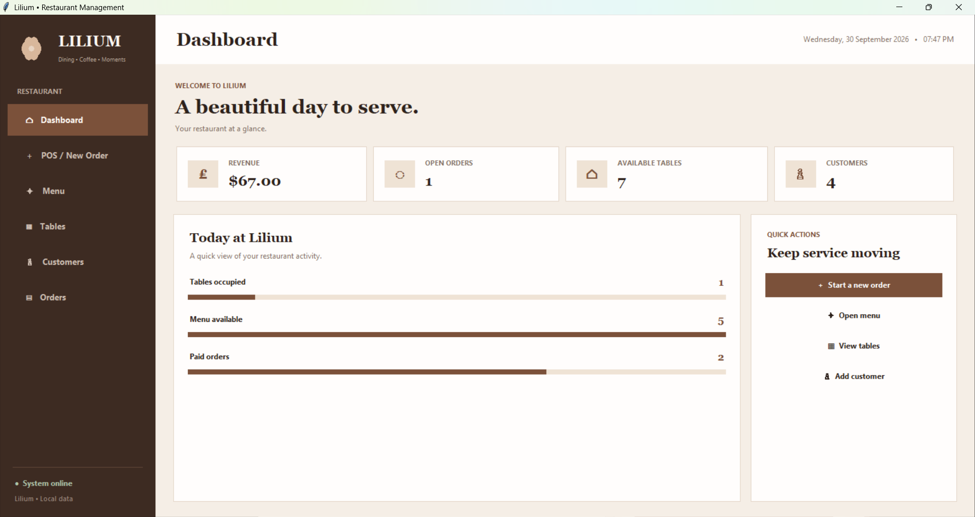
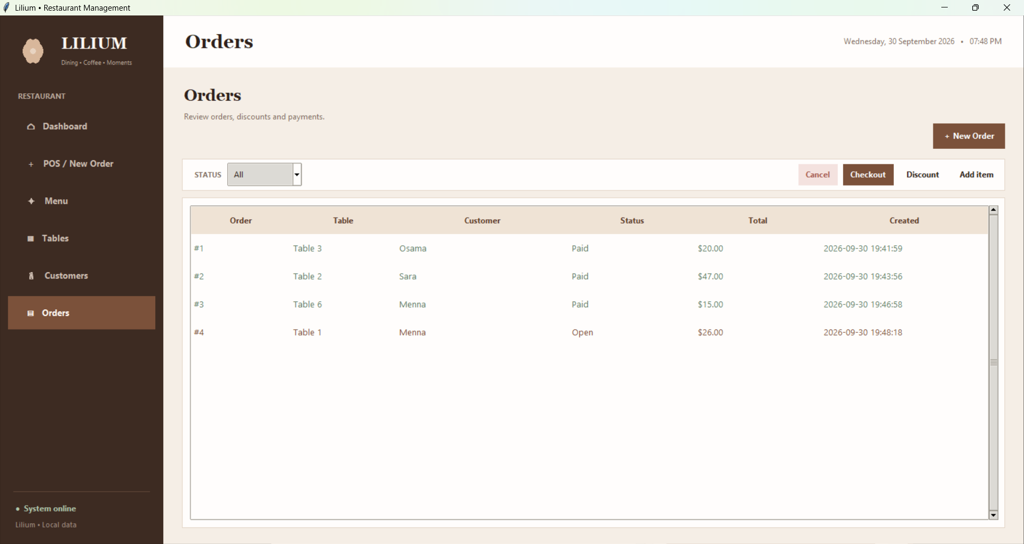
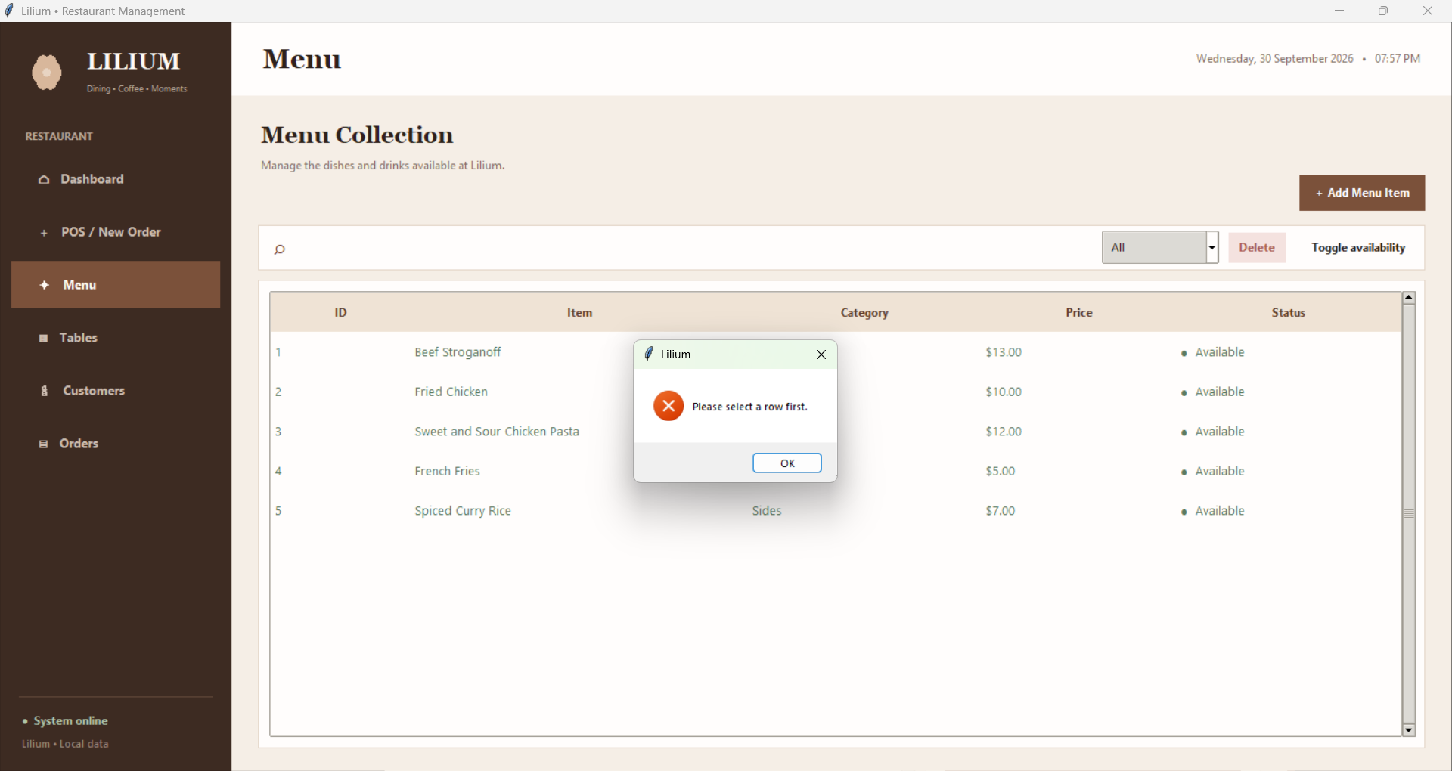
THE INTERFACE
A thin Tkinter client on top of the model
Real data
Forms and tables
Clear feedback
The dashboard shows live numbers from dashboard_stats()
Dialogs call the model methods
Errors appear as readable messages
Notes:
Put your three screenshots in the frames. The GUI only calls Restaurant methods and shows str(error) in message boxes. All rules stay in the models.

Slide 15
TESTING THE DESIGN
10 scenarios prove the rules hold
3
3
2
2
Successful flows
Invalid input
Business rules
Edge cases
add item, full order, search
negative price, zero quantity, missing table
occupied table, empty checkout
merged items, 100% discount and cancel
with pytest.raises(TableOccupiedError):
restaurant.create_order(table_id=1)
Notes:
Run with: pytest tests/test_scenarios.py -v

Slide 16
SUMMARY
OOP concepts and where they live
Encapsulation
Abstraction
MenuItem.__price with property setter
Discount(ABC) with abstract methods
Inheritance
Polymorphism
RestaurantError and its 10 subclasses
discount.apply() inside Order
Composition
Class methods
Restaurant, Order and OrderItem
from_dict() on each model
Special methods
Separation of concerns
__str__ on every model
models, service, FileManager, GUI
Notes:
Recap: point at each row and name the class that demonstrates it.

